Slide 1
Where to go on vacation
Predicting best destinations based on user ratings of past vacation destinations

Slide 2
Presentation content:
Introduction, background and problem
Data acquisition
Cities and features selection
Methodology
Analysis
Results, discussion and conclusion

Slide 3
Introduction, background & problem:
Most people go on vacation every year, spending an average of $1,536 for household in USA.
Lots of possible destinations, and impossibility of studying them all without wasting a lot of time.
Need for a beater solution, which tells the user which are the top destinations for him/her based on him/her past experiences.

Slide 4


Data acquisition:
Data will be extracted from two main sources:
Foursquare
Geopy.geocoders

Slide 5
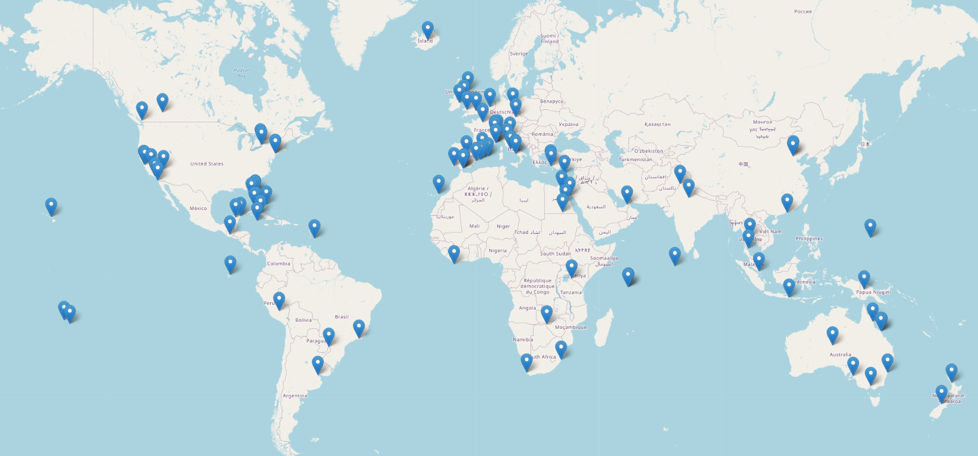
Cities and features selection
We will use a total of 100 cities as vacation candidates, which are:
For the features, we will use the total number of venues of each category a city has. We will search for venues from a total of 100 different categories

Slide 6
Cities and features selection
We will use a total of 100 cities as vacation candidates, which are:
For the features, we will use the total number of venues of each category a city has. We will search for venues from a total of 100 different categories

Slide 7
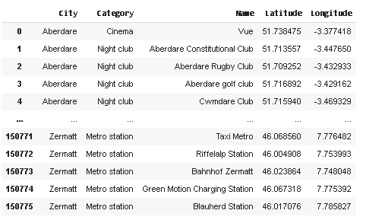
Methodology
We will search for every feature of every city, and save the returned venues from the foursquare API. We will have a table like this:

Slide 8
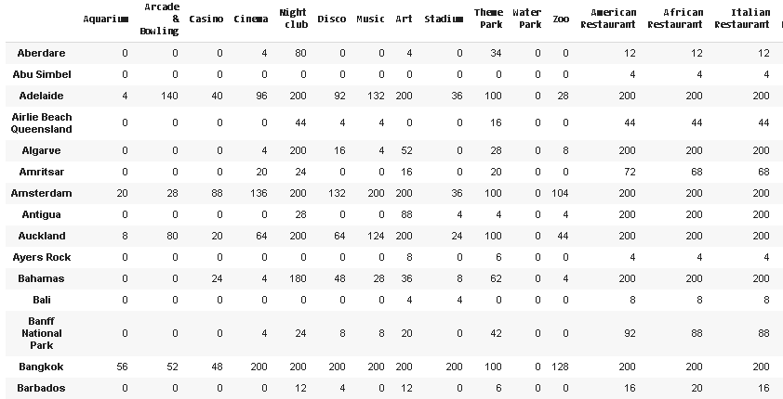
Methodology
The next step is to sort all this data, and create a new table with every city in one row, and 100 columns, each with one feature. Each cell will contain the number of venues of that category that exist in that city:

Slide 9
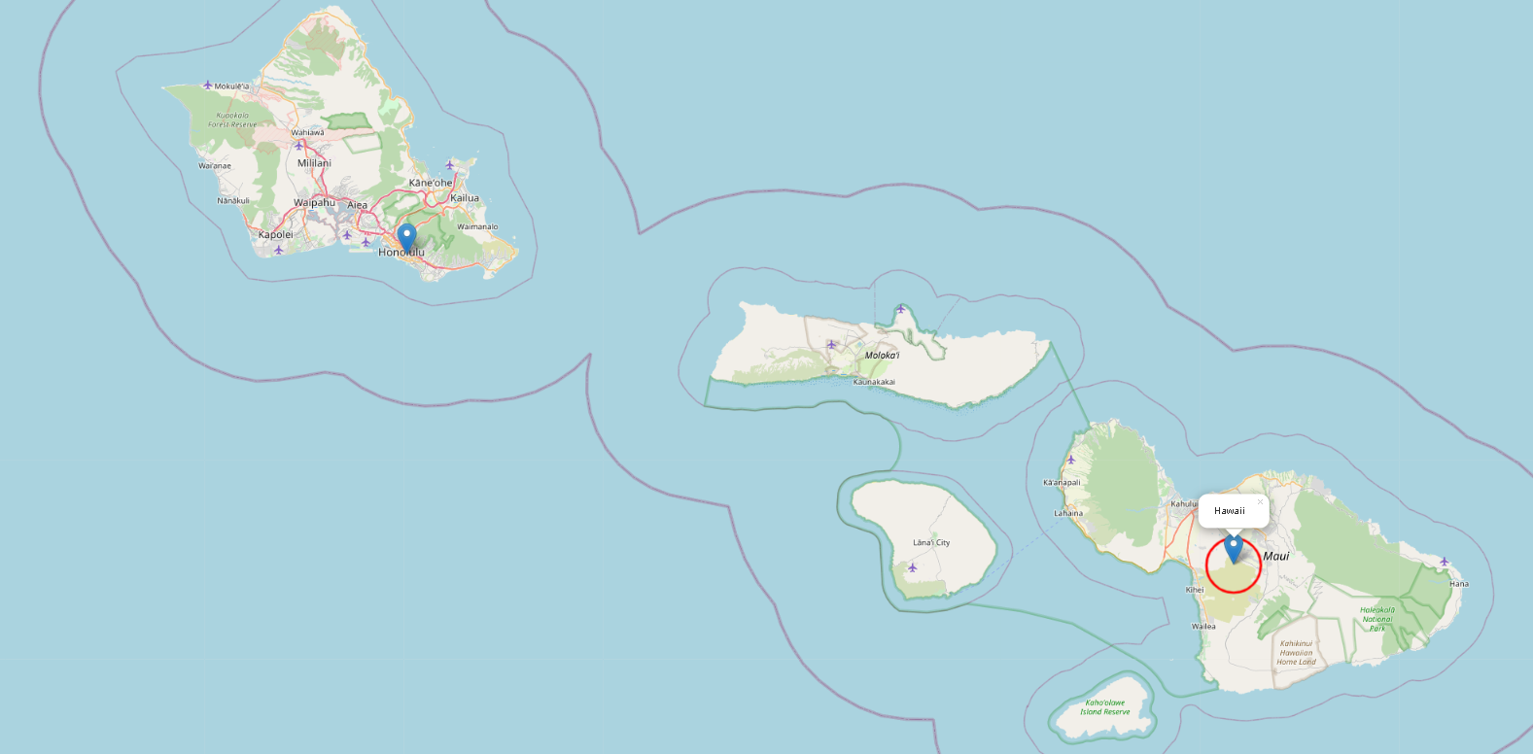
Methodology
The next step is to see if there are any cities that should be discarded because it has few sites. This may be because Foursquare has little data about a site, because we put the coordinates wrong (for example, we put the name of a country or region instead of a city) or that the place simply has few sites. An example of a misnomer is for example the place "Hawaii". However, when looking for the coordinates in geocoders, putting the name of Hawaii instead of the name of its capital (Honolulu) returned us a location far from any city.

Slide 10
Methodology
The next step is to see if there are any cities that should be discarded because it has few sites. This may be because Foursquare has little data about a site, because we put the coordinates wrong (for example, we put the name of a country or region instead of a city) or that the place simply has few sites. An example of a misnomer is for example the place "Hawaii". However, when looking for the coordinates in geocoders, putting the name of Hawaii instead of the name of its capital (Honolulu) returned us a location far from any city.
After dropping invalid places we have 78 places left.

Slide 11
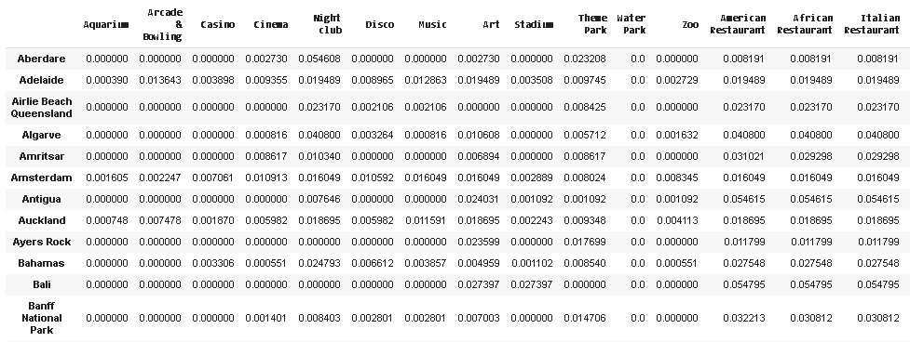
Methodology
Now we normalize our data set.

Slide 12
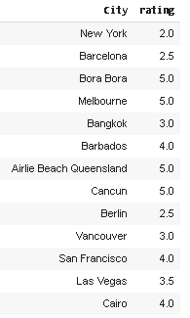
Custom client part
The next thing is defining a user's score to previous cities to see where their next vacation should be.
For this we will invent a user, whose scores will be:

Slide 13
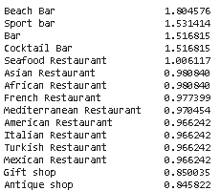
Custom client part
From the user ratings and the Cities features, we can compute how much the user likes each feature. For this user we get:

Slide 14
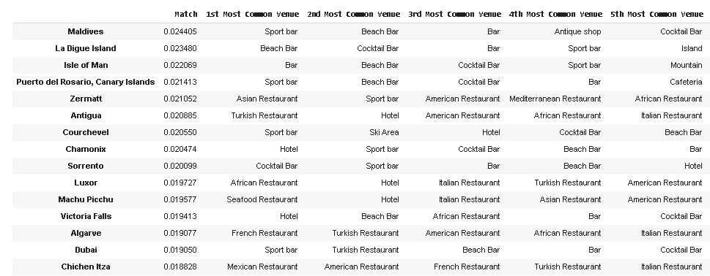
User recomendations
Once we have the user predilection for each feauter, we can compute the user favourites cities, which are:

Slide 15
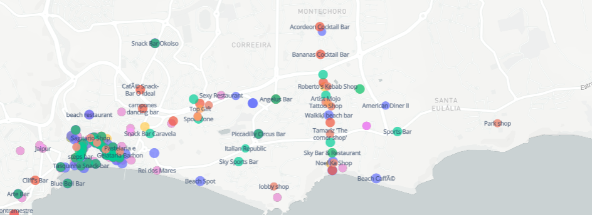
User recomendations
Toghether with the table showing the best matches and the top venues of each city, we provide a dashboard where the user can select a city from the recommended list, and the city and it’s venues will show in a map:

Slide 16
Results, discussion and conclusion
The result of this project is the recommended sites for a particular user.
As has been seen and explained, the scores entered clearly correspond to a person with little interest in big cities, someone who enjoys relaxing vacations much more, in quiet places and especially with the beach. We can see, as of the 15 recommended cities, except Dubai, the other cities are relatively quiet cities, and most are beach, so it seems that the algorithm works quite well, and the recommendations are good.
In conclusion, we can say that this program is a good tool when planning a vacation, since due to the wide range of places to go, and how quickly they all change, it is difficult to know where to go, and where you will find what you are looking for
The final decision of where to go will be up to the client, but good recommendations are made.

